Slide 1

GAME DEV WITH ALLEGRO 5
Getting Started

Slide 2
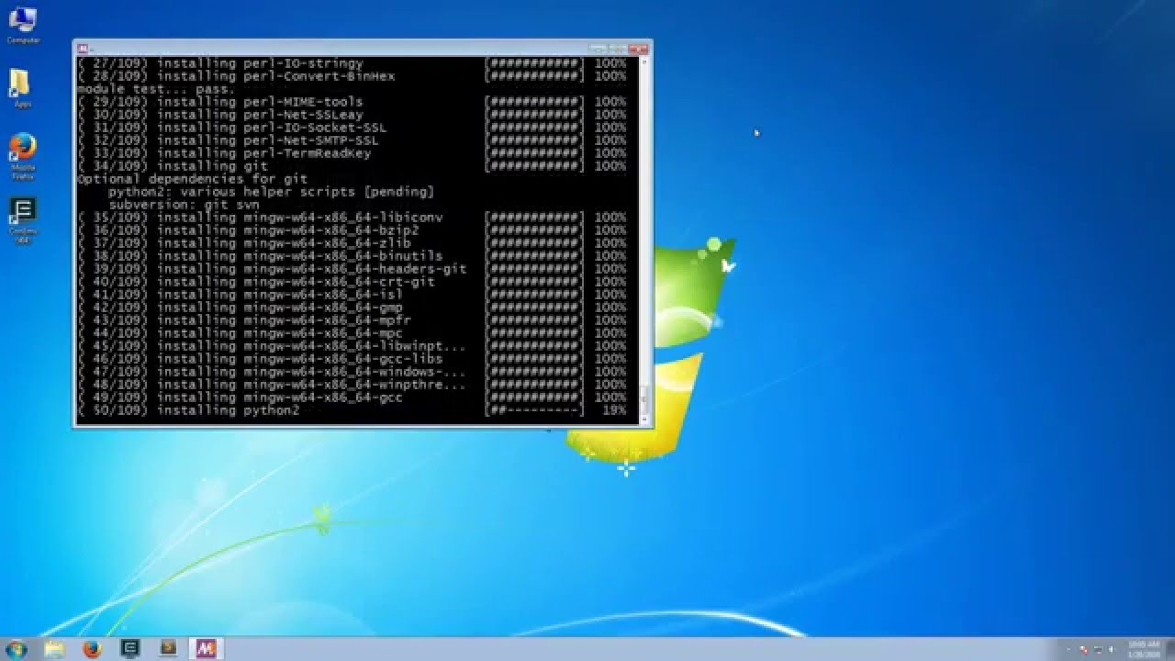
Making Use of MSYS2
Open up MSYS2 (32 or 64 bit)
Type in pacman -S mingw-w64-x86_64-allegro
This will install Allegro 5
Type in pacman -S mingw-w64-x86_64-dumb mingw-w64-x86_64-flac mingw-w64-x86_64-freetype mingw-w64-x86_64-libjpeg-turbo
mingw-w64-x86_64-libpng mingw-w64-x86_64-libvorbis
mingw-w64-x86_64-libwebp mingw-w64-x86_64-openal
mingw-w64-x86_64-opusfile

Slide 3
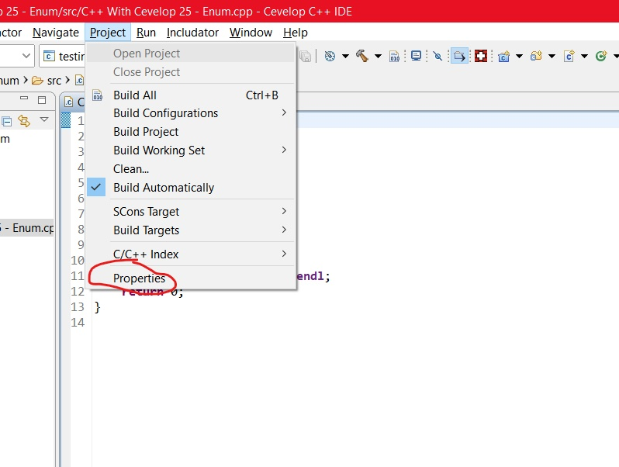
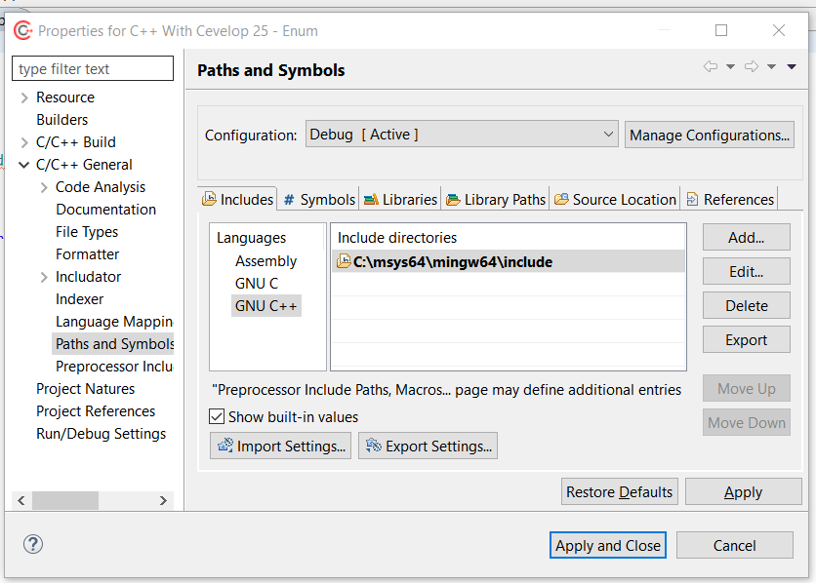
Adding the Library - Include
Open up Cevelop
Create a Project
Go to Project and go to Properties
Expand C/C++ General
Click on Preprocessor Paths and Symbols
Click on the Includes tab
Click on the GNU C++ in the Includes tab
Click on the Add button
Click on the File System
Go to C:\msys64\mingw64\include
click Select Folder
Click Ok

Slide 4
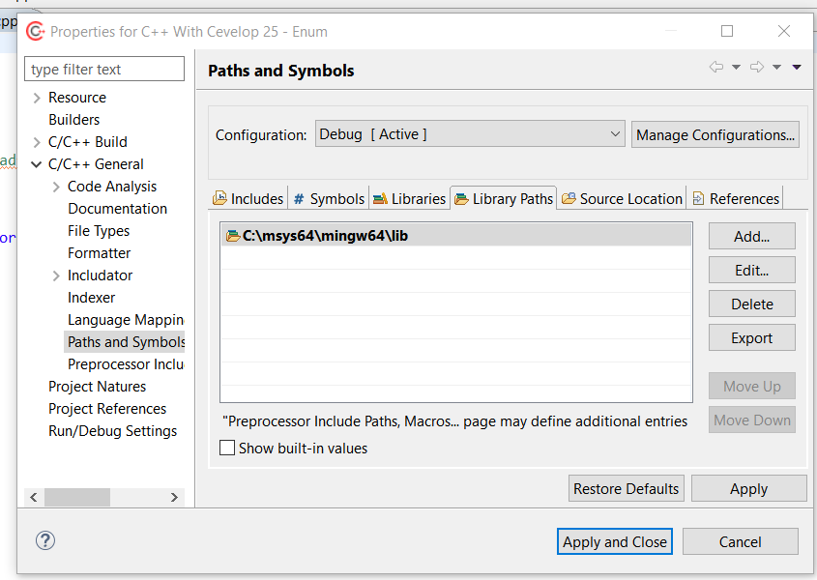
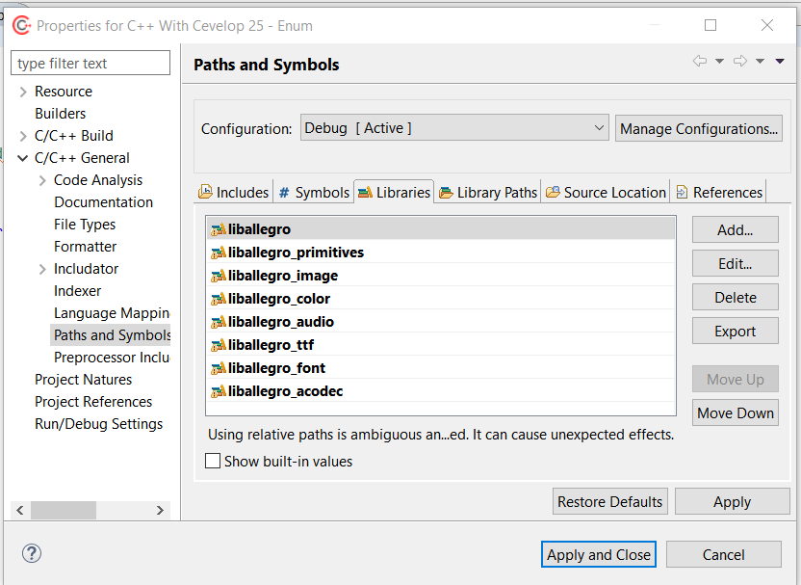
Adding the Library - Libs
Click on the Library Path tab
Click on the Add button
Click on the File system
Go to C:\msys64\mingw64\lib
click Select Folder
Click on the Libraries tab
Click Add
Put in liballegro and click Ok
Repeat the last step for liballegro_primitives, liballegro_image, liballegro_audio, liballegro_color, liballegro_acodec, liballegro_ttf, liballegro_font

Slide 5
Sample Code
#include <iostream>
#include <allegro5/allegro.h>
#include <allegro5/allegro_primitives.h>
using namespace std;
int main() {
al_init();
al_init_primitives_addon();
ALLEGRO_DISPLAY *window = al_create_display(500, 500);
al_clear_to_color(al_map_rgb(255,0,0));
al_draw_filled_circle(100, 100, 50, al_map_rgb(0, 0, 0));
al_flip_display();
al_rest(5.0);
al_destroy_display(window);
return 0;
}

